Slide 1

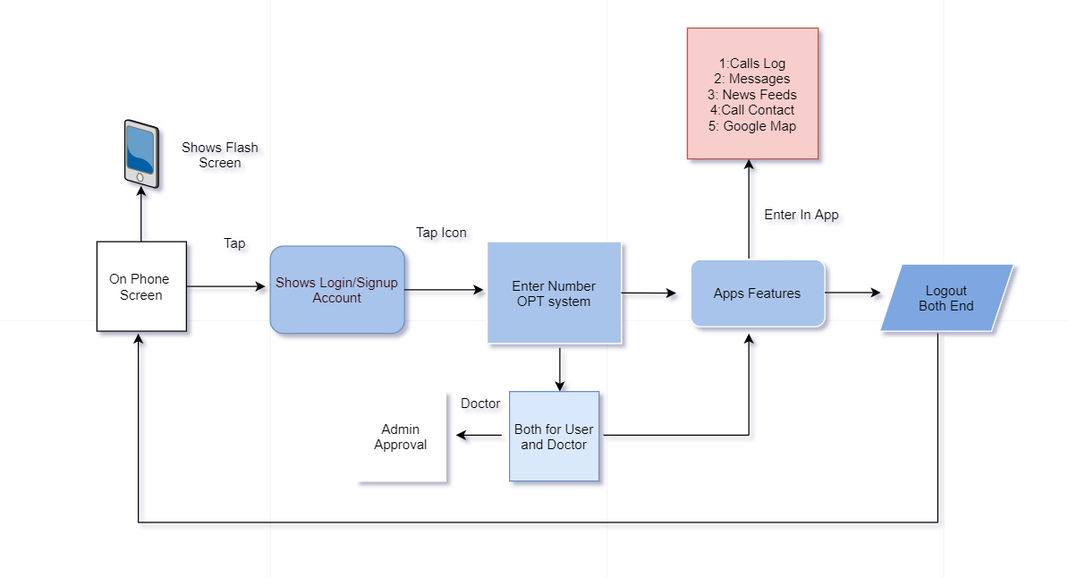
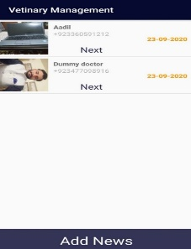
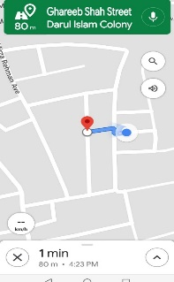
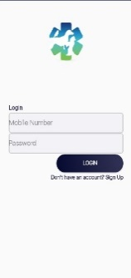
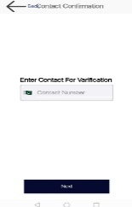
^{A PET CARE} ^{Final Year Project (2017-2021)} ^{Department of Computer Science} COMSATS University Islamabad, Attock Campus
Introduction
Our project is based on android application of a pet care system to provide an easy and comfort platform to user. As we know in this modern and technologically advanced world everyone have smartphone and everyone find a solution using smartphone. And on the other hand everyone have pets in their home, we provide a way to take care of your pet based on mobile application. Having a pet can be a stressful and exhausting experience. So to tackle this situation this application is easier and non-exhausting way to take care of your pet. The pet safety and protection. In this application there is a multiple consoles, one console is for doctor and second console is for user/pet owner.
Motivations
This application is a great contribution to solve problems of people, by using our technical skills and to learn the mobile application development. We initiated this application with the purpose of making something new, unusual and beneficial to our society..
Related work done by other
11 pets: pet care (App)
Weakness
Application is develop but not have proper security system. In this app user cannot upload many problems all user upload one by one problem and not given location and doctors feedbacks.
Proposed project Solution: Our application is develop in such way that its provide proper security system. We provide OTP code for security verification. We also set admin approval security system for doctors. We provide location of the doctor so user easily visit.
Architecture
Results
Conclusion
Pet care is an android application and its purpose is to help the people. This application includes basic modules of messaging, calling , news feed and location access that a person can make calls, send SMS and search a specific person from the contact list.
A person who is using this app can also get the call logs and messages of a person whom he or she wants to contact. We used the Google for the access of location.
User Application
.
Future Directions
We create a proper panel for interview to doctor side
We recommend a some diets for our pets to take care health.
May be we dropout our this database and create the database to another for our app efficient
If our database is large reason we don’t run on a local database if our app make more efficient and our data is shifted to moracle or another place
Objectives
Group Members
Aadil Munir
CIIT/SP17-Bcs-040/ATK
Ahsan Ayaz
CIIT/FA16-BCS-002/ATK
Supervisor: Co-Supervisor:
DR. Muhammad Sharif Muhammad Fahad
Provide a easy path to user, that help him/her for take caring for their pets
Increase in the knowledge and better treatment of pets.
Use easily find solution to their problems
The user will able to seek a good veterinarian doctor

